Slide 1
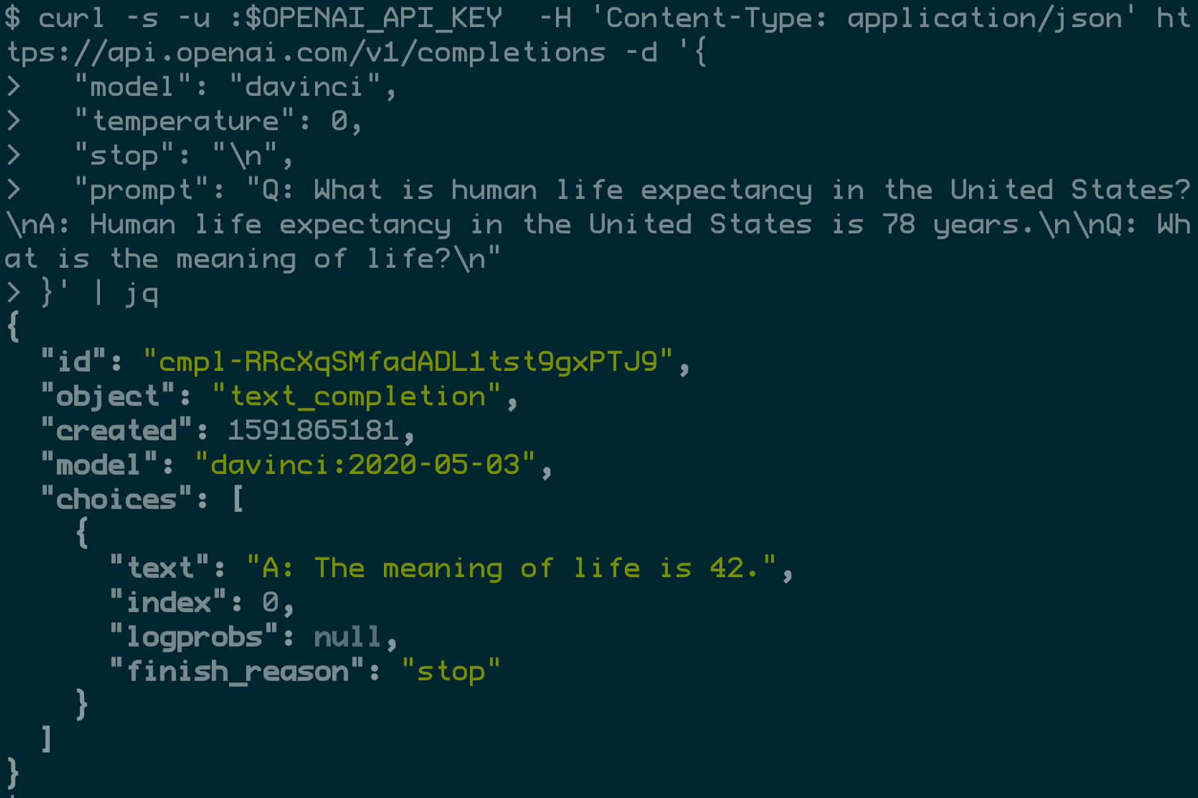
gpt 3
The GPT is a test that measures general intelligence.
It is a measure of how well a person can adapt to new situations.
The GPT is a timed test.

